Slide 1
Rupinder Kaur Bhatti
Ph - +1 825-288-2066 Email - rupinderk44@gmail.com Linkedin - https://www.linkedin.com/in/rupinder-kaur-49aba338b/
Front-End Developer | Creating Modern, High-Performance Websites.

Slide 2
About me
I have experience as a Front Developer working on 10+ projects, where I built and customized responsive, high-quality websites and applications. I work confidently with HTML, CSS, JavaScript, Bootstrap, WordPress, and Shopify to create clean interfaces and smooth user experiences. I collaborate well with teams, troubleshoot issues quickly, and focus on delivering reliable, efficient, and user-friendly digital solutions. I also have knowledge of Python and expertise in customizing designs using Photoshop and Figma. I enjoy combining clean code with creative design to deliver seamless, high-quality web experiences.

Slide 3
Skills & Expertise
Front-End Development: HTML, CSS, JavaScript, Bootstrap, Responsive Design, Cross-Browser Compatibility
CMS & eCommerce: WordPress, Shopify, WooCommerce, Theme & Plugin Customization
Programming & Scripting: Python, Basic Automation, Web Functionality Enhancement
Design & Prototyping: Adobe Photoshop, Figma, UI/UX Design, Layout Customization
Tools & Collaboration: Git/GitHub, VS Code, Project Collaboration, Troubleshooting & Debugging
Other Expertise: Website Performance Optimization, SEO Basics, Content Management, Mobile-Friendly Design

Slide 4
My Work

Slide 5

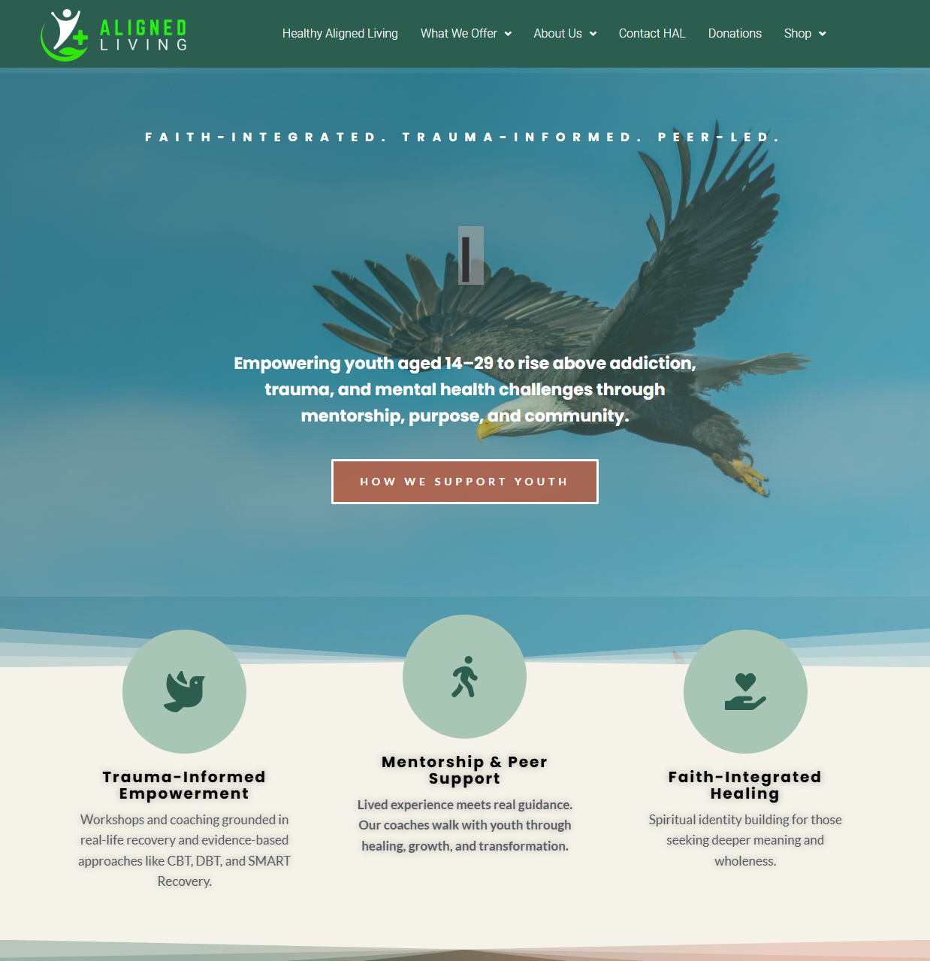


Healthy Aligned Living
WordPress Website Designed and developed a clean, user-friendly WordPress site for Healthy Aligned Living. The project included setting up essential pages, integrating email notifications, and configuring a secure WooCommerce payment gateway for smooth customer checkout. · Payment gateway setup · WooCommerce · Email integration · WooCommerce dropshipping setup

Slide 6
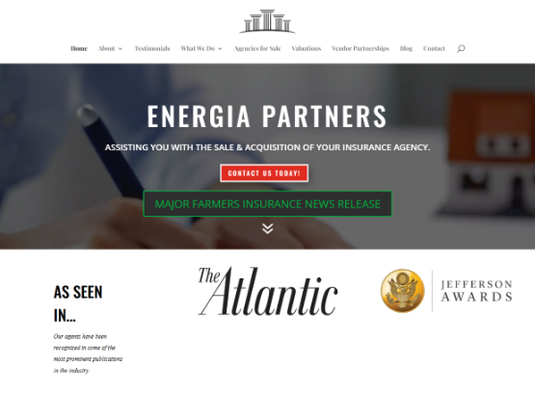
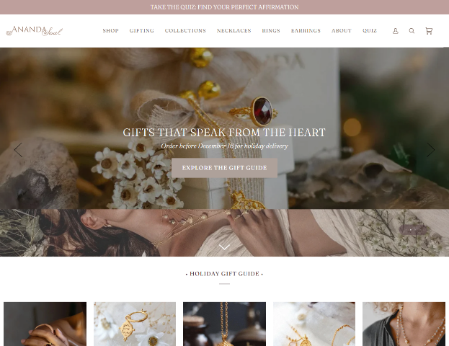

ENERGIA PARTNERS
Ananda Soul(Jewelry Store)
Designed and built the Energia Partners website — a professional, accessible consulting site focused on agency sales and acquisitions.
Designed and developed the Ananda Soul website, creating a responsive, user-friendly e-commerce site that showcases the brand’s handcrafted, spiritual jewelry.

Slide 7
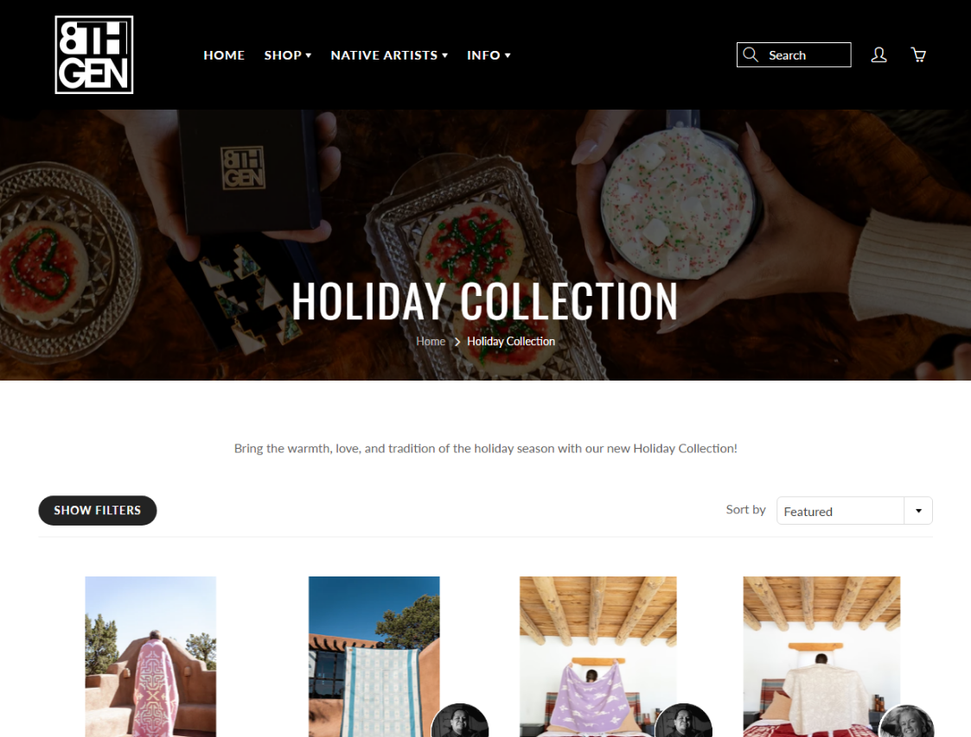
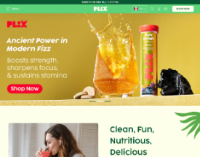
Eighth Generation (Store)
Plix (Shopify Store)
Built and maintained the online storefront for Eighth Generation — a Seattle-based, Tribal-owned lifestyle brand delivering authentic Native-designed wool blankets, home goods, and jewelry.
I contributed to PlixLife’s plant-based wellness site by improving performance, enhancing UI/UX, and optimizing product pages for a smoother shopping experience

Slide 8
Full Project List
https://www.ebuilderz.com/
http://namanmodi.com/
https://healthscience.com/
https://alexandcompany.com/
https://www.greenelementsstl.com/ https://njcrecycling.com/
https://allcountysewer.com/
https://spanjersigns.com/
https://www.wilmingtonurgentclinic.com/
https://www.aceautorecyclingcolorado.com/
https://www.notothequo.com/
https://www.drainlogics.com/
https://www.beverlyhillshr.com/
https://www.equaljusticecoalition.net/
http://linvoxcorp.com/
https://caymancigars.com/

Slide 9
Career highlights
Wordpress Assistant
Healthy aligned living, Edmonton (Remote)
Mar 2025 - Nov 2025
Supervisor
Chandan Janitorial services ltd, calgary, Canada
Jan 2023-Mar 2025
Freelance Web Designer
Nov 2022-Apr 2018 Operations Administrator
Hotel Zenith, Punjab, India
May 2018-Nov 2022

Slide 10

Contact
Rupinder Kaur
Rupinderk44@gmail.com
https://www.linkedin.com/in/rupinder-kaur-49aba338b/

